Slide 1
Ryan’s Slides
RiskArt Trade Mark

Slide 2
Risk Factors in Portfolio
125 risk factors
3 equities
3 underlying spot prices for options
2 FX rates
3 interest rate curves = 45 risk factors
72 CDS hazard rates (9 CDS’s * 8 times point’s)
25 Corporate bond spreads (1 for each of our 25 bonds)

Slide 3
Modeling 1 Year Value at Risk
Geometric Brownian Motion: equities, spot prices
Cox–Ingersoll–Ross: CDS hazard rates, FX rates, bond spreads
Vasicek: interest rate term structures
Cash flows were reinvested at the risk free rate
One year computation allows us to consider the theta of the portfolio
Square root of time rule is inaccurate over a whole year

Slide 4
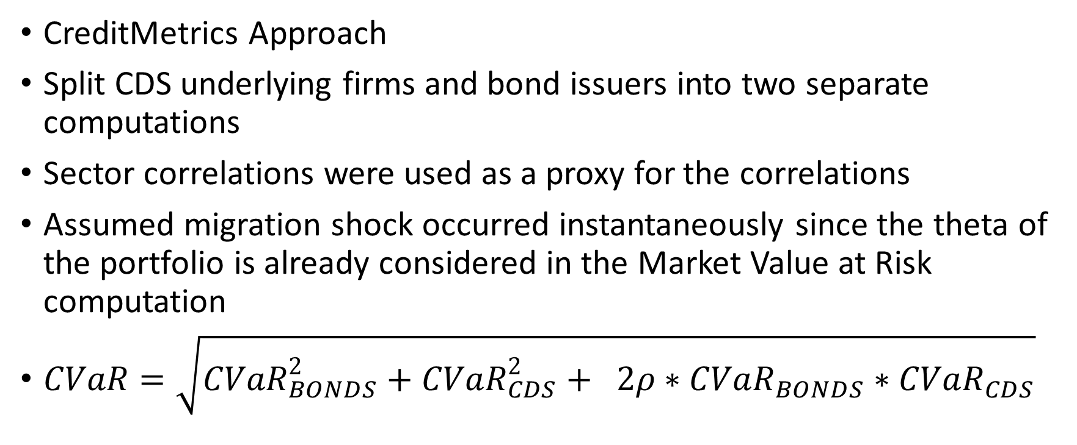
Credit Value at Risk
CreditMetrics Approach
Split CDS underlying firms and bond issuers into two separate computations
Sector correlations were used as a proxy for the correlations
Assumed migration shock occurred instantaneously since the theta of the portfolio is already considered in the Market Value at Risk computation
$CVaR=\sqrt{CVaR_{BONDS}^{2}+CVaR_{CDS}^{2}+ 2ρ∗CVaR_{BONDS}∗CVaR_{CDS}}$

Slide 5
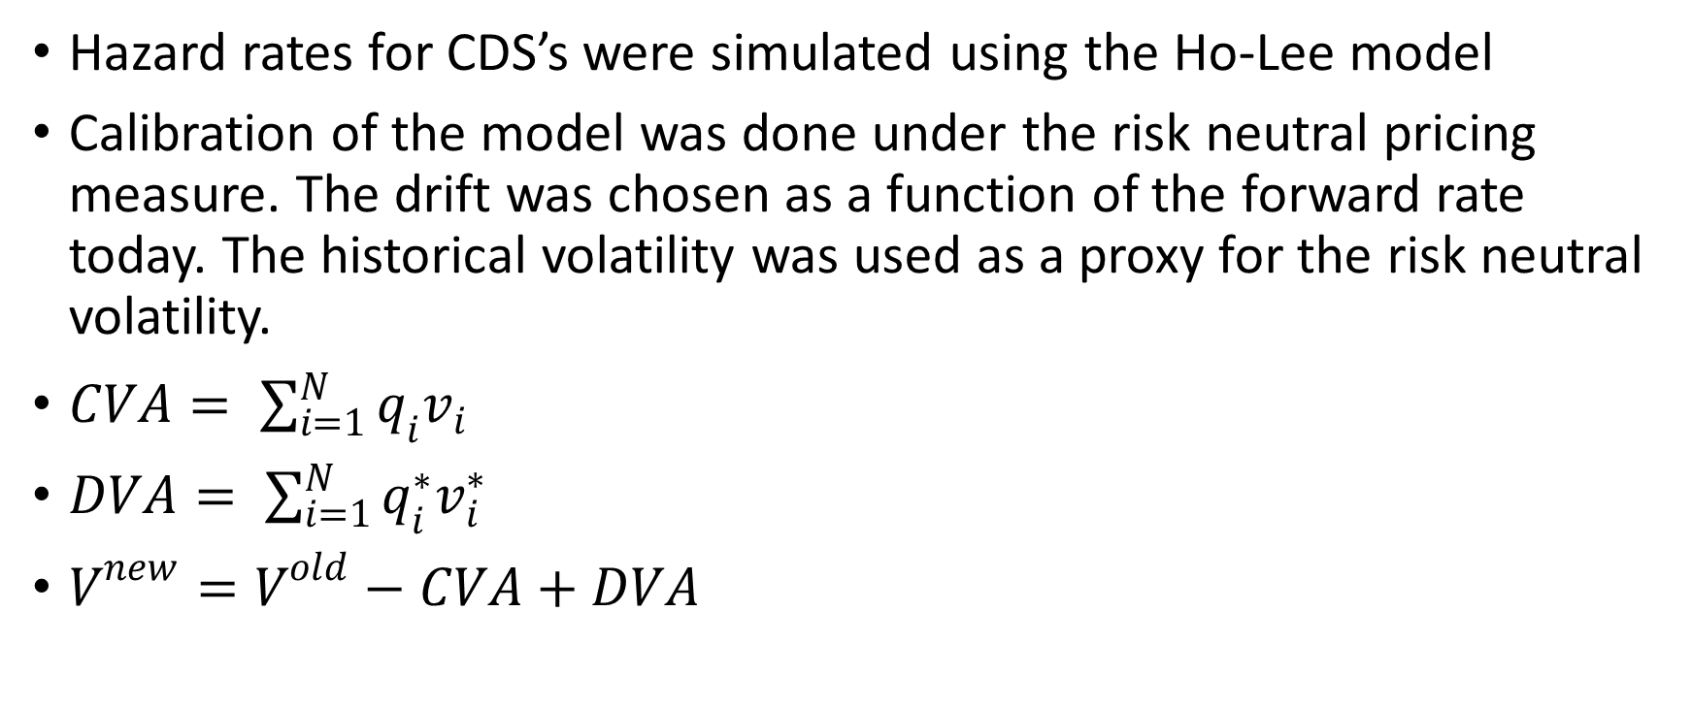
Credit and Debt Value Adjustment
Hazard rates for CDS’s were simulated using the Ho-Lee model
Calibration of the model was done under the risk neutral pricing measure. The drift was chosen as a function of the forward rate today. The historical volatility was used as a proxy for the risk neutral volatility.
$CVA= \sum_{i=1}^{N}{q_{i}v_{i}}$
$DVA= \sum_{i=1}^{N}{q_{i}^{∗}v_{i}^{∗}}$
$V^{new}=V^{old}−CVA+DVA$

Slide 6
Model Vetting Techniques
Compare VaR magnitude to portfolio value
Compare pricing functions to current market prices today
Compare historical and Monte Carlo models
Compare 1 year VaR to scaled VaR from 1 day computation
Backtesting: moving window compared to out of sample data
Standard statistical tests could not reject the validity of our models

